Slide 1
Actionable Steps to Web Data Analysis

Slide 2
What was the basis
of the most recent recommendation you made?
E-COMMERCE
LEAD
SEO
SOCIAL MEDIA
MANAGER
WEB
DEVELOPER
COPYWRITER

Slide 3
ABOUT ME

Slide 4
“You Can’t Manage What You Can’t Measure”
ASSUMPTIONS:
Very familiar with how the different analytics tool works
You have identified goals, objectives, strategies and KPIs
You have clear understanding of the metrics and/or dimensions provided by your Analytics ToolYou have set traffic inclusion/exclusion rules for data analysis
Your conversion, event or interaction tracking is already in place
In-depth knowledge of the core business processes of your company

Slide 5
CONTEXT is QUEEN
“Remember all data is secondary.
Your primary quest is to understand the business context.”

Slide 6
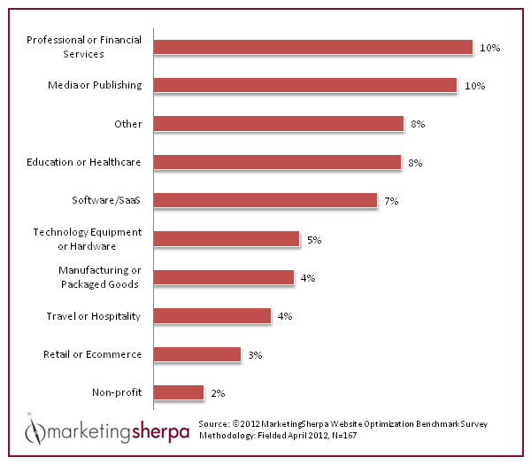
Benchmark
INTERNET BOOKING ENGINE
E-COMMERCE WEBSITE
INDUSTRY
DATA
COMPETITIVE
SET
Having the industry and competitive set datapoints let’s you know where your company performance stand vs competitors and the industry in general.
YOU

Slide 7
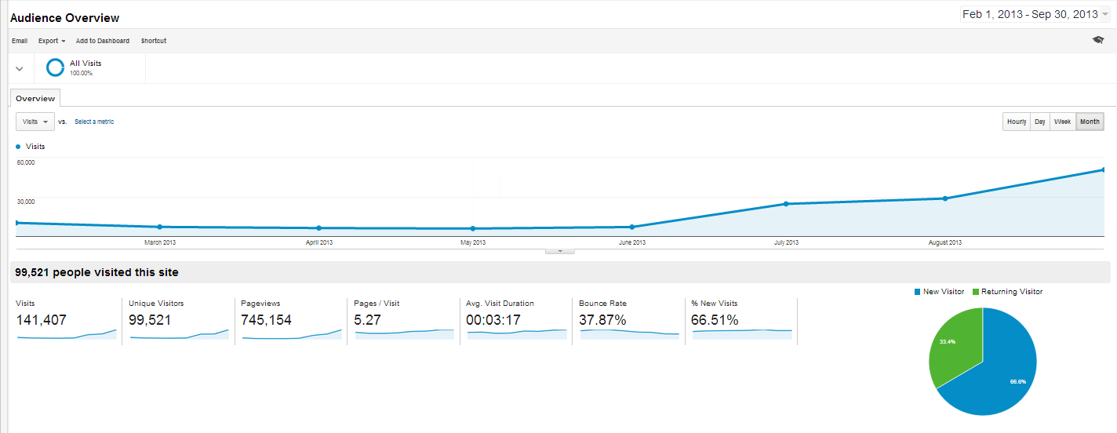
Time Series
Traffic Month-On-Month indicates that we are getting better at bringing traffic to the website. (YEY!)

Slide 8
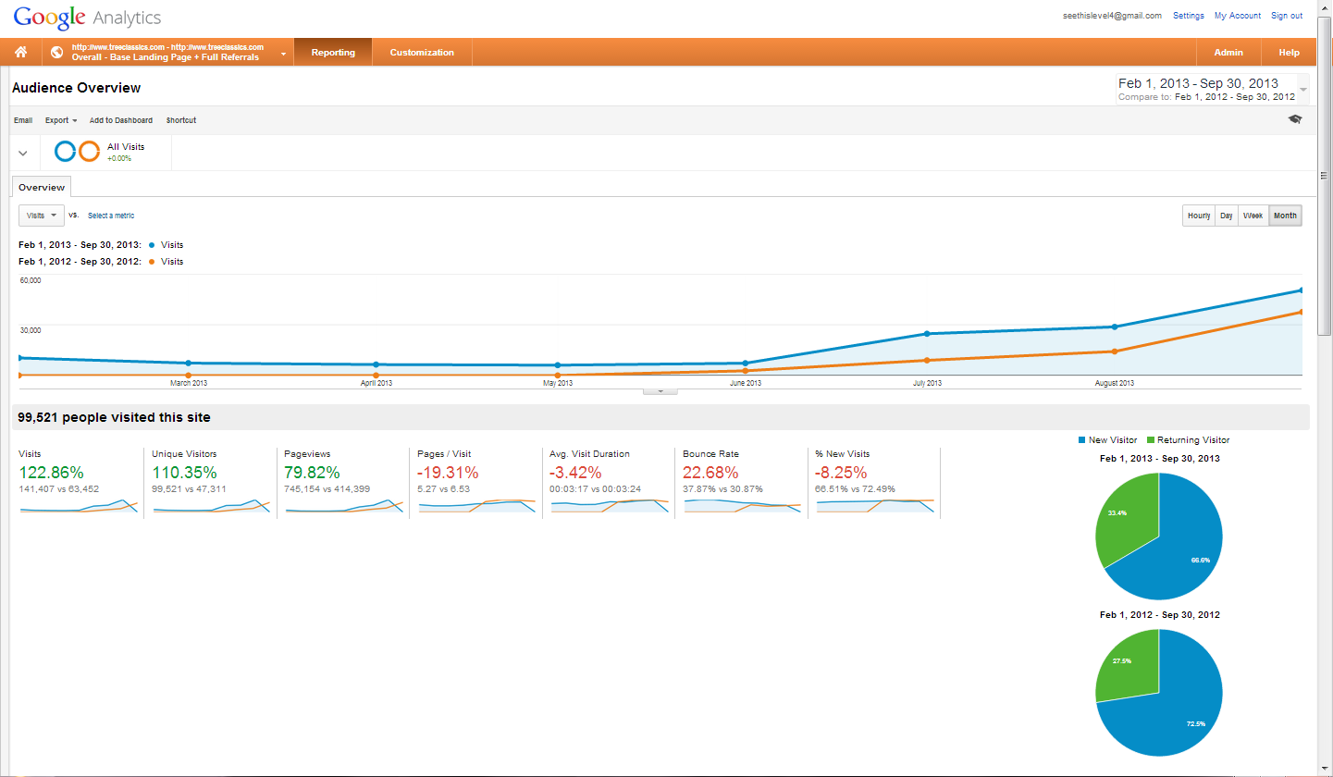
Time Series Comparison
Traffic Year-On-Year indicates that we are getting better at bringing in traffic to the website... But then,
What happened to site engagement?
What did we do differently this year?

Slide 9
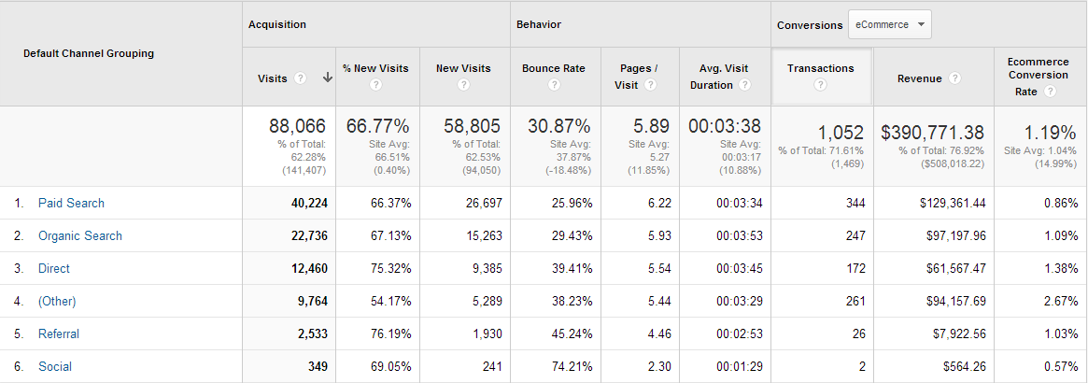
End-To-End
An End-to-End view will provide a better understanding of performance
METRIC GROUP
ACQUISITION | How much traffic are brought into the website?
BEHAVIOR | How good is the landing page at making traffic explore and interact with the site further?
CONVERSION | How much of the traffic contributed to the goal achievement?

Slide 10
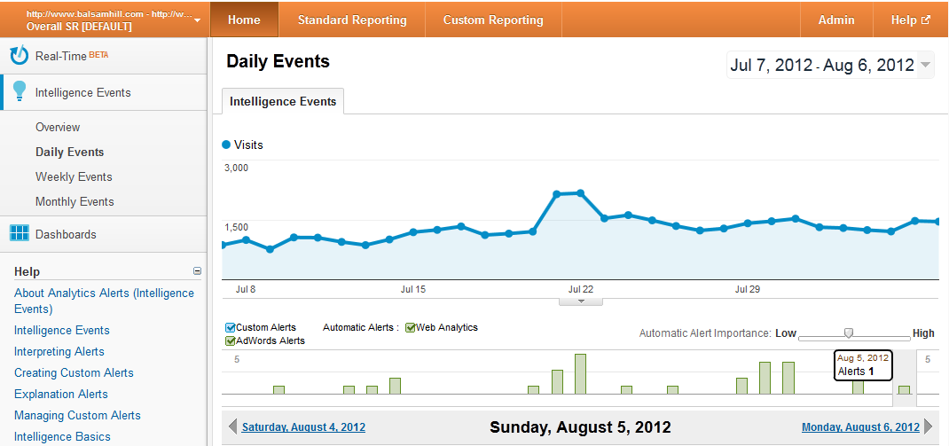
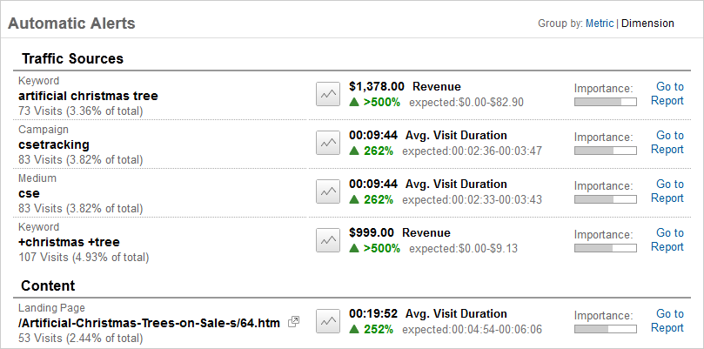
What Happened?
Seasonal Dives
Intelligence Events helps to quickly spot important alerts that stand out

Slide 11
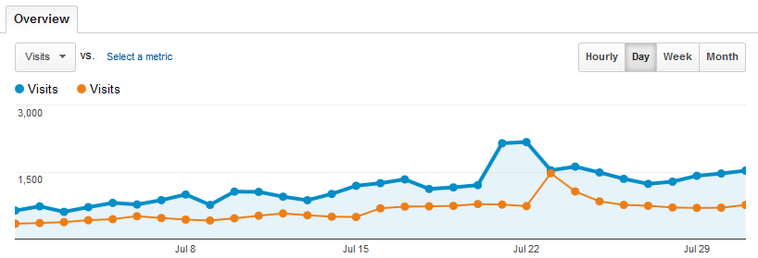
Why Is Traffic Up/Down?
Dives
Daily view YoY helps to find lifts or issues
Offset the graph where necessary to match up day of the week fluctuations
YoY helps more than MoM due to our seasonal business

Slide 12
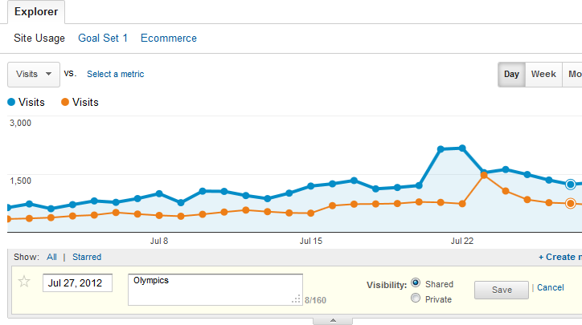
Why Is there A Spike? Part I
Seasonal Dives
Click on the dots to add annotations
Always consider external/internal events
Annotate major events for institutional memory

Slide 13
Why Is there A Spike? Part 2
Seasonal Dives
Compare with two metrics over time to spot interesting changes
Take care with low traffic amounts and spikes in rates

Slide 14
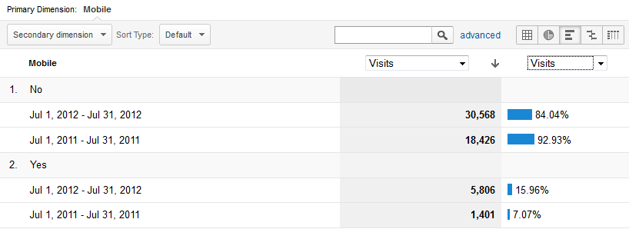
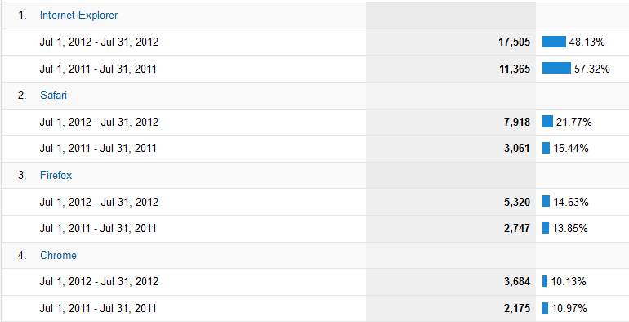
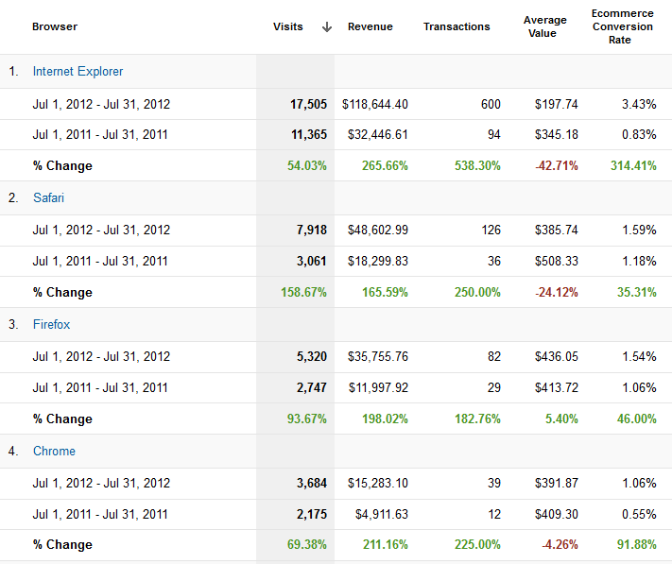
How Are Interactions Changing?
Seasonal Dives
Design variations can create a large impact if subject to devices, browsers, etc shifts

Slide 15
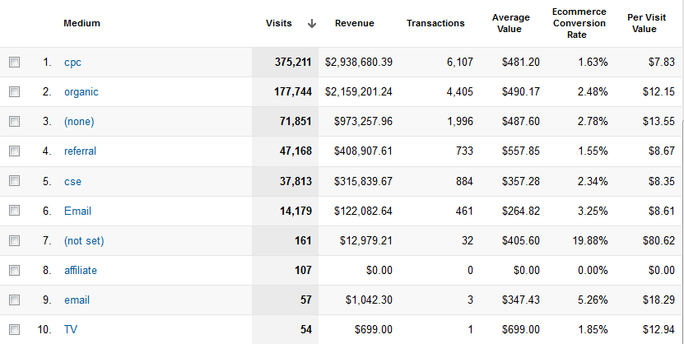
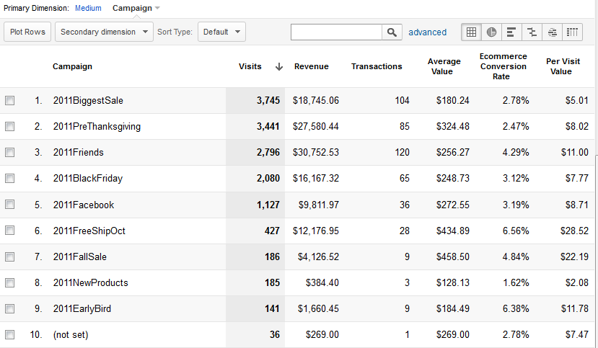
Which Campaign Worked Best?
Source Dives
Where are the conversions happening and how can we improve our best performers?

Slide 16
What Are We Missing…?
Source Dives
Help our analyses get better: What are we not tagging? What is incorrectly tagged?

Slide 17
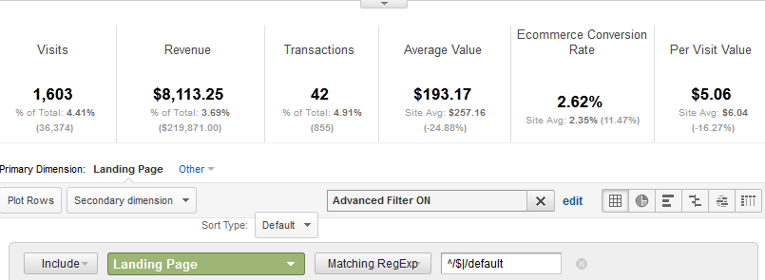
Does Entry Page Type Change Behavior?
Page Data Dive
Where are the conversions happening and how can we improve our best performers?
Product Pages
Category Pages
Home Pages

Slide 18
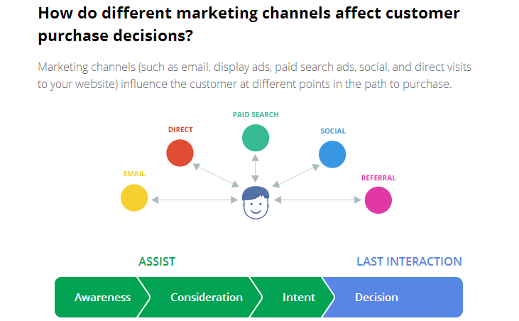
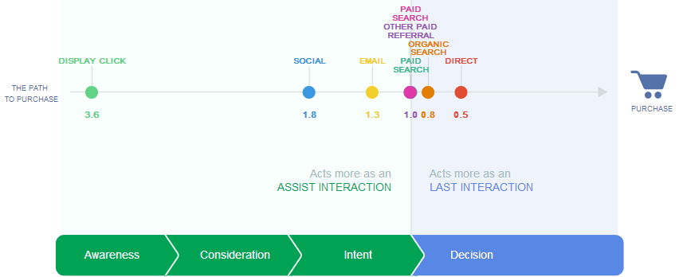
The Paradigm Shift
AWARENESS
CONSIDERATION
Customer evaluates what options s/he has to fulfill his/her needs.
INTENT
Customer is inclined to choose one option over the others to fulfill needs.
DECISION
Customer realizes that a business can potentially fulfill his/her needs
Customer takes action after careful emotional and/or logical thought process

Slide 19
Web Analytics Paradigm
EXPERIMENTATION
and TESTING
VOICE OF CUSTOMER
COMPETITIVE
INTELLIGENCE
INSIGHTS
MULTIPLE OUTCOMES
CLICKSTREAM
 | Data that measures pages, campaigns and site behavior such as Visits, Visitors, Pageviews, Bounce Rates.
 | Data that connects customer behavior to the bottomline of the companies focused on increasing revenue, reducing cost and more satisfied customers.
 | Data that masures which among different ideas and/or options the customers determines to work best.
 | Data that provide direct feedback of what the customer wanted but did not see in the website.
 | Data that will provide information on show your business is doing compared to the competitors.

Slide 20
CASE STUDY: The Online Booking Experience
IS IT
A DEAL
OR NO DEAL?
Notes:
Canyon Cove Resort

Slide 21
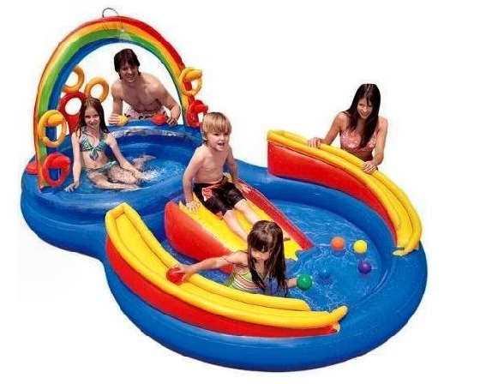
CASE STUDY: The Online Shopping Experience
Half Empty
or Half “Pool”?
Notes:
Online

Slide 22
Questions? delapena.sheila@gmail.com

