Slide 1
CONTENT PLAYBOOK
How to scale content marketing.
Hiring a group of content creators is only the first step towards building a strong content marketing strategy. Reinforce your talent with a solid foundation of process, management and analytics.

Slide 2
CAVEAT
I “jackdapted” the concepts in this presentation.
The concepts in this presentation were adapted from the YouTube playbook for brands presented by the Google Product Marketing team. I originally learned of this content playbook at Google Think B2B conference in Mountain View back in 2015. Over the past year I have adapted the concepts for my overall content marketing strategy.
Source:
https://www.thinkwithgoogle.com/playbooks/youtube.html

Slide 3
FIRST PRINCIPLES
Good content comes from good ideas.
No matter how talented your content team is… they can’t create good content from bad ideas. And let’s face it! Most ideas aren’t that great. Often you need to come up with dozens of ideas before one proves to be worth pursuing.

Slide 4
IDEA DROUGHT
Running out of ideas is the worst.

Slide 5
IDEA RESERVOIR
Build a process around an endless stream of inspiration.
Building a regular program that relies on a constant stream of inspiration will ensure your idea reservoir continues growing. That way you can be selective and develop only the best of ideas. The crème de la crème.

Slide 6
CONTENT PIPELINE
Pretty hard to find a photo of a pipeline.

Slide 7
HERO
3 CONTENT PIPES
Wow! That went viral.
Content that sizzles! People are sharing, customers are calling and competitors are crying. The true definition of a viral marketing strategy. The goal here is to drive brand awareness.

Slide 8
HERO
3 CONTENT PIPES
HUB
Wow! That went viral.
Subscribe to my channel.
Content that sizzles! People are sharing, customers are calling and competitors are crying. The true definition of a viral marketing strategy. The goal here is to drive brand awareness.
Regularly published content that sticks to a tried and true formula or template. Your predictable (and dependable) format is comforting to a loyal readership (or viewership). Your goal here is to drive engagement.

Slide 9
HERO
3 CONTENT PIPES
HUB
HELP
Wow! That went viral.
Subscribe to my channel.
Frequently asked questions.
Content that sizzles! People are sharing, customers are calling and competitors are crying. The true definition of a viral marketing strategy. The goal here is to drive brand awareness.
Regularly published content that sticks to a tried and true formula or template. Your predictable (and dependable) format is comforting to a loyal readership (or viewership). Your goal here is to drive engagement.
Long tail informational content focused on “know” search queries. Your customer service team will praise you as the genius you are and lavish you with gifts. Your goal here is acquisition and/or retention.

Slide 10
IDEA SPRINGS
Finding the well or river that keeps flowing with ideas.

Slide 11
IDEA SPRINGS
HUB
SOURCES:
Customers
Tutorial/Use Case Requests
Customer Reviews
Customer Success
Complex CS Questions
Industry
New Product Launches
Technology Advancement
Legislative Changes
Seasons and Events/Holidays

Slide 12
IDEA SPRINGS
HUB
HELP
SOURCES:
Customers
Tutorial/Use Case Requests
Customer Reviews
Customer Success
Complex CS Questions
Industry
New Product Launches
Technology Advancement
Legislative Changes
Seasons and Events/Holidays
SOURCES:
Customers
Simple CS Questions
Product Returns and Refunds
Suppliers / Vendors
Product Manuals
Training Documents
Social / UGC
Quora, Forums, Facebook, etc.
Competitors Knowledge Base

Slide 13
IDEA SPRINGS
HERO
HUB
HELP
SOURCE:
Old fashioned imagination & creativity. This is where you content team gets to think outside the box and shoot for the moon.
SOURCES:
Customers
Tutorial/Use Case Requests
Customer Reviews
Customer Success
Complex CS Questions
Industry
New Product Launches
Technology Advancement
Legislative Changes
Seasons and Events/Holidays
SOURCES:
Customers
Simple CS Questions
Product Returns and Refunds
Suppliers / Vendors
Product Manuals
Training Documents
Social / UGC
Quora, Forums, Facebook, etc.
Competitors Knowledge Base

Slide 14
IDEA RESERVOIR
It’s really just a backlog, but let’s stick to the water symbolism.

Slide 15
THE BACKLOG
HUB
NEW PRODUCTS:
DJI Phantom 4 Unboxing
DJI Phantom 3 Pro vs 4
Feiyutech Gimbal for FLIR Vue Pro
GDU Byrd Drone
DSLR Pros EO/IR Solution
DJI Osmo Extension Pole
Feiyutech Summon Camera
Eken Action Camera

Slide 16
THE BACKLOG
HUB
HELP
NEW PRODUCTS:
DJI Phantom 4 Unboxing
DJI Phantom 3 Pro vs 4
Feiyutech Gimbal for FLIR Vue Pro
GDU Byrd Drone
DSLR Pros EO/IR Solution
DJI Osmo Extension Pole
Feiyutech Summon Camera
Eken Action Camera
CHAT TRANSCRIPTS:
Don’t know how to update their firmware on the Phantom 4
Don’t understand the different types of memory cards (Class 10, U3, etc)
Unbalanced / tilted gimbal correction and calibration
Don’t know what the beeping on their drone means

Slide 17
THE BACKLOG
HERO
HUB
HELP
BRAIN STORM SESSIONS:
Drone delivering a 24 pack of beer to demonstrate the heavy payload capability of Titan X8
Drone Fire Ball – Set an older Phantom 2 on fire and fly it while shooting video in EO and IR
NEW PRODUCTS:
DJI Phantom 4 Unboxing
DJI Phantom 3 Pro vs 4
Feiyutech Gimbal for FLIR Vue Pro
GDU Byrd Drone
DSLR Pros EO/IR Solution
DJI Osmo Extension Pole
Feiyutech Summon Camera
Eken Action Camera
CHAT TRANSCRIPTS:
Don’t know how to update their firmware on the Phantom 4
Don’t understand the different types of memory cards (Class 10, U3, etc)
Unbalanced / tilted gimbal correction and calibration
Don’t know what the beeping on their drone means

Slide 18
SIMPLE CALENDAR
Keep it simple, stupid! K.I.S.S.

Slide 19
SIMPLE CALENDAR
7/3
7/10
7/17
7/24
7/31
8/7
8/14
8/21
8/28
HERO
HUB
Knowledge Base
Knowledge Base
Knowledge Base
Knowledge Base
Knowledge Base
Knowledge Base
Knowledge Base
HELP

Slide 20
SIMPLE CALENDAR
7/3
7/10
7/17
7/24
7/31
8/7
8/14
8/21
8/28
HERO
Product Unboxing
Demo Tutorial
Product Unboxing
Demo Tutorial
HUB
Knowledge Base
Knowledge Base
Knowledge Base
Knowledge Base
Knowledge Base
Knowledge Base
Knowledge Base
HELP

Slide 21
SIMPLE CALENDAR
7/3
7/10
7/17
7/24
7/31
8/7
8/14
8/21
8/28
First Exclusive
HERO
Product Unboxing
Demo Tutorial
Product Unboxing
Demo Tutorial
HUB
Knowledge Base
Knowledge Base
Knowledge Base
Knowledge Base
Knowledge Base
Knowledge Base
Knowledge Base
HELP

Slide 22
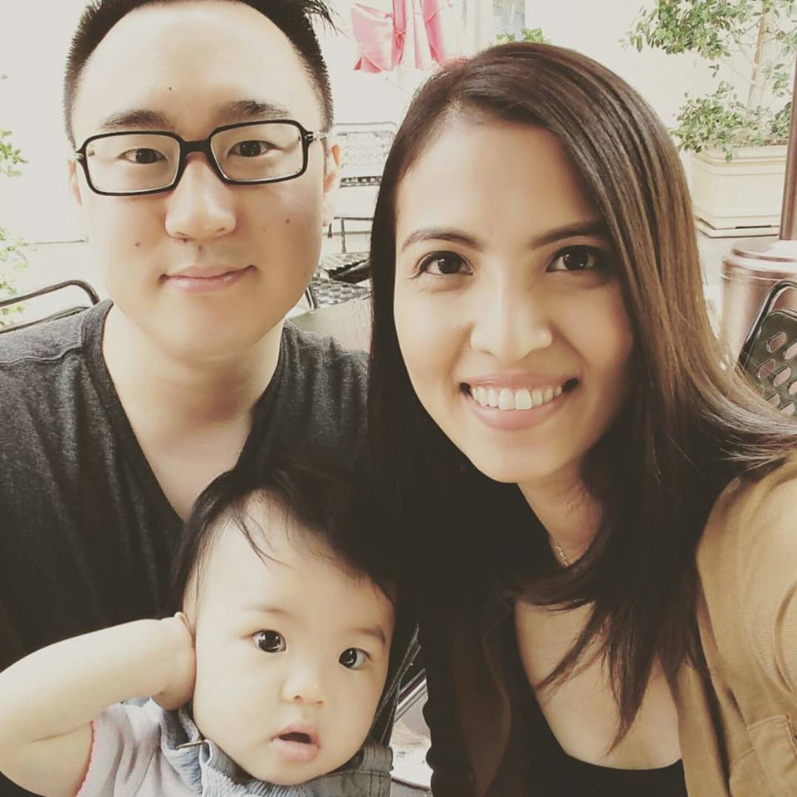
THANK YOU

